Slide 1

Introduction to algorithms
Seminar 8
w/c:22 November 2021

Slide 2
Difference between leaf and leaf-node
T:
leaf-node: any node that has no children
15
17
18
left(left(T))=
leaf
isLeaf(left(left(T)))=
TRUE
7
11
isLeaf(right(left(T)))=
TRUE
How to check a leaf-node?
if isLeaf((left(T)) && isLeaf((right(T))
then leaf-node

Slide 3
homework
countLeaf(binT)
Write a recursive algorithm that counts the number of leaf nodes of a binary tree
Is it O(n) or O(h)??

Slide 4
delete leaf-nodes of a bt
Write a recursive algorithm delLeaf(binT) that deletes the leaf nodes of a binary tree.
T1:
T2:
15
15
delLeaf(T1)
17
18
18
11

Slide 5
delete leaf-nodes of a bt
Write a recursive algorithm delLeaf(binT) that deletes the leaf nodes of a binary tree.
Algorithm: delLeaf(binT)
Requires: a binary tree (BT)
Returns: a binary tree without the previous leaf nodes
1. if isLeaf(left(binT)) && isLeaf(right(binT)) then
2. return leaf //base case (deletes leaf node)
3. else
4. return node(delLeaf(left(binT)),root(binT),delLeaf(right(binT)))//recursive call
5. endif
makes a new BT

Slide 6
delete leaf-nodes of a bt - trace
15
1. if isLeaf(left(binT)) && isLeaf(right(binT)) then
2. return leaf //base case (deletes leaf node)
3. else
4. return node(delLeaf(left(binT)),root(binT),delLeaf(right(binT)))//recursive call
5. endif
17
18
Line 1: FALSE
18
Line 4:
node(delLeaf(
17
),15,delLeaf(
))
11
11
Line 1: TRUE
Line 1: FALSE
11
Line 2: leaf
Line 4:
node(delLeaf(
leaf
),18,delLeaf(
))
node(leaf,15,node(leaf,18,leaf)))
15
Line 1: TRUE
Line 1: TRUE
18
Line 2: leaf
Line 2: leaf

Slide 7
Max node in a bt
Write a recursive algorithm maxBT(binT) that finds the max node value of a binary tree.
Algorithm: maxBT(binT)
Requires: a binary tree (BT)
Returns: the maximum node value
Algorithm: max(a,b)
if a>b then
return a
else
return b
endif
if isLeaf(binT) then
return 0 //base case 1 (empty tree)
elseif isLeaf(left(binT)) && isLeaf(right(binT)) then
return root(binT) //base case 2 (single-node tree)
elseif isLeaf(left(binT))
return max(root(binT),maxBT(right(binT))) //recursive call (check right subtree)
elseif isLeaf(right(binT))
return max(root(binT),maxBT(left(binT))) //recursive call (check left subtree)
else
return max(root(binT),max(maxBT(left(binT)),maxBT(right(binT))))//recursive call(check both sides)
endif

Slide 8
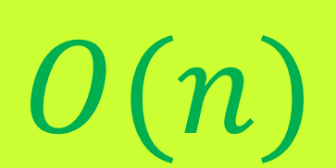
Maximum node in a binary tree – trace!!
15
10
max(15,max(maxBT(
17
),maxBT(
)))
7
18
17
10
max(15,max(17,
max(10,max(maxBT(
7
),maxBT(
18
))))
7
18
max(15,max(17,
max(10,max(7,18))))
= 18
n-1 comparisons for n nodes
$$O(n)$$

Slide 9
Maximum node in a bst
Write a recursive algorithm maxBST(bsT) that finds the max node value of a binary search tree.
Facts about any BST:
The smallest number can be found on the left subtree.
The largest number can be found on the right subtree.
Algorithm: maxBST(bsT)
Requires: a binary search tree (BST)
Returns: the maximum node value
if isLeaf(right(bsT)) then
return root(bsT) //base case (empty right subtree)
else
return maxBST(right(bsT)) //recursive call (check right subtree)
endif

Slide 10

Maximum node in a bst – trace!!
Write a recursive algorithm maxBST(bsT) that finds the max node value of a binary search tree.
Facts about any BST:
The smallest number can be found on the left subtree.
The largest number can be found on the right subtree.
$$O(h)$$
8
5
maxBST(
)
7
11
3
1
8
maxBST(
11
)
return root(
11
)
= 11
7
11
How many recursive calls??

Slide 11
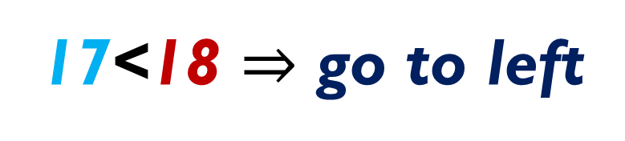

Searching for a node in bst
searchBST(x,bsTree)
15
Do we need to check every node?
7
18
Compare 17 to root value 15
17>15 $⇒$ go to right
0
16
21
Compare 17 to root value 18
17
17<18 $⇒$ go to left
…

Slide 12
homework
Write a recursive algorithm for searching an element in BST
searchBST(x,bsTree)
Is it O(n) or O(h)??

Slide 13
isBST??
How do you check whether a BT is a BST or not??
15
max(left(tree)) < root(tree)
&&
7
18
min(right(tree)) > root(tree)
4
16
21
2
6
17
if a BT is a BST

Slide 14
isBST??
How do you check whether a BT is a BST or not??
15
max(left(tree)) > root(tree)
Can you write the algorithm?
||
7
18
min(right(tree)) < root(tree)
4
16
21
2
6
17
BT is NOT a BST

